Slide 1
Knightly Knockout
1 v 1 multiplayer swordfighting game

Slide 2
Table of contents
Server
Login and Register
01
03
Server side data storage
Optimisation
02
04
Correctly deployed node.js server
Able to register accounts and log in
Server stores profile pictures, database stores client info
How the game has been further optimised to reduce loading time and increase framerate

Slide 3
Table of contents
Game Audio
01

Slide 4
INTRODUCTION
Knightly Knockout is a first person 1v1 swordfighting game. The first player to win 3 round wins.
The game will be networked multiplayer.

Slide 5
01
Server
Correctly deployed node.js server

Slide 6
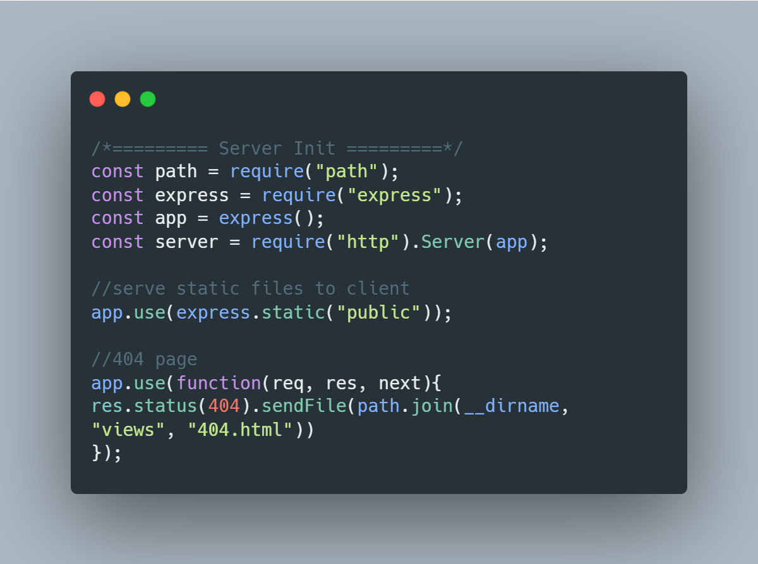
Server
The server is deployed on replit and is run using node. Npm is used to download packages such as express

Slide 7
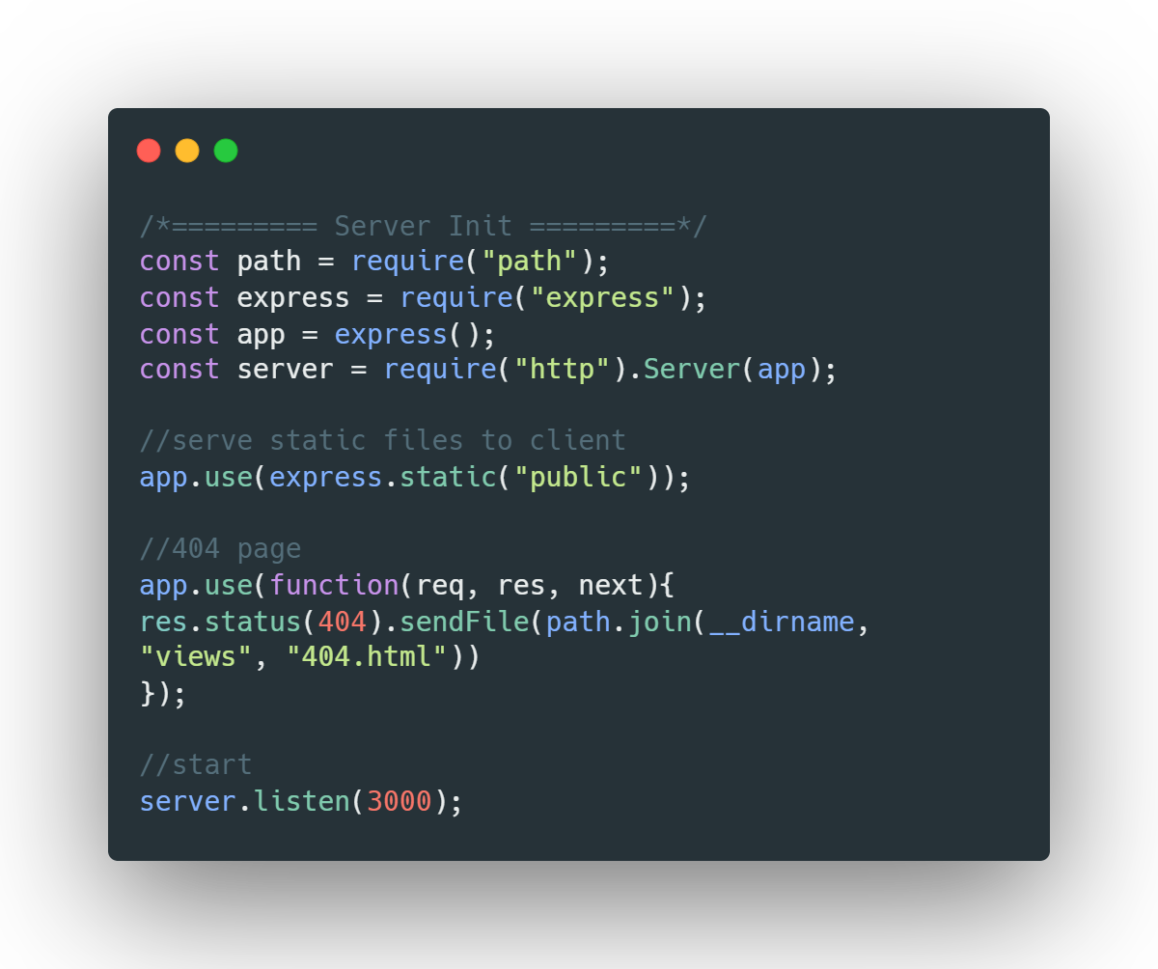
Express Code

Slide 8
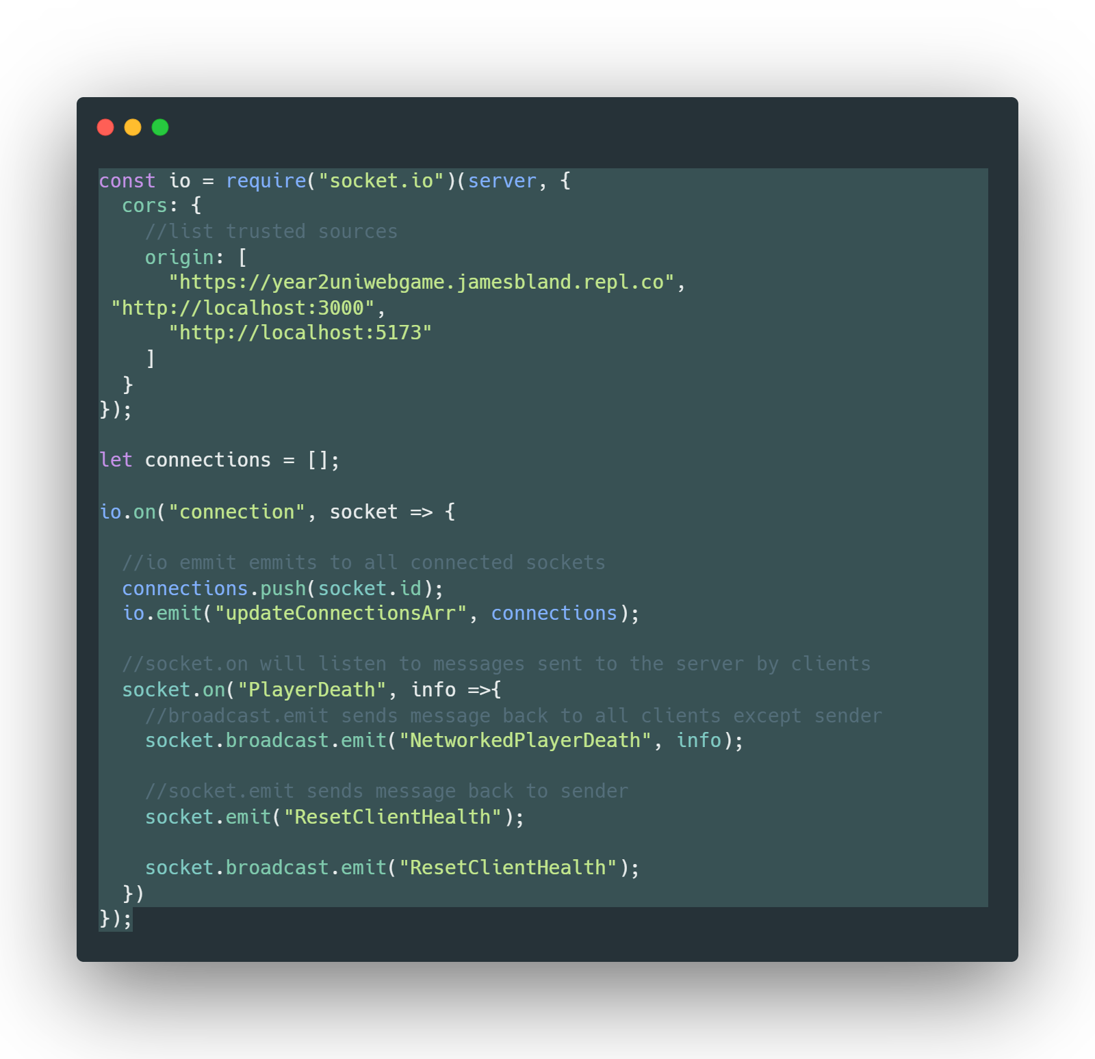
Additional Server info
Socket io is used for the multiplayer for the server. And is able to pass messages back and forth between the clients

Slide 9
02
Server side data storage
Server stores profile pictures, database stores client info

Slide 10
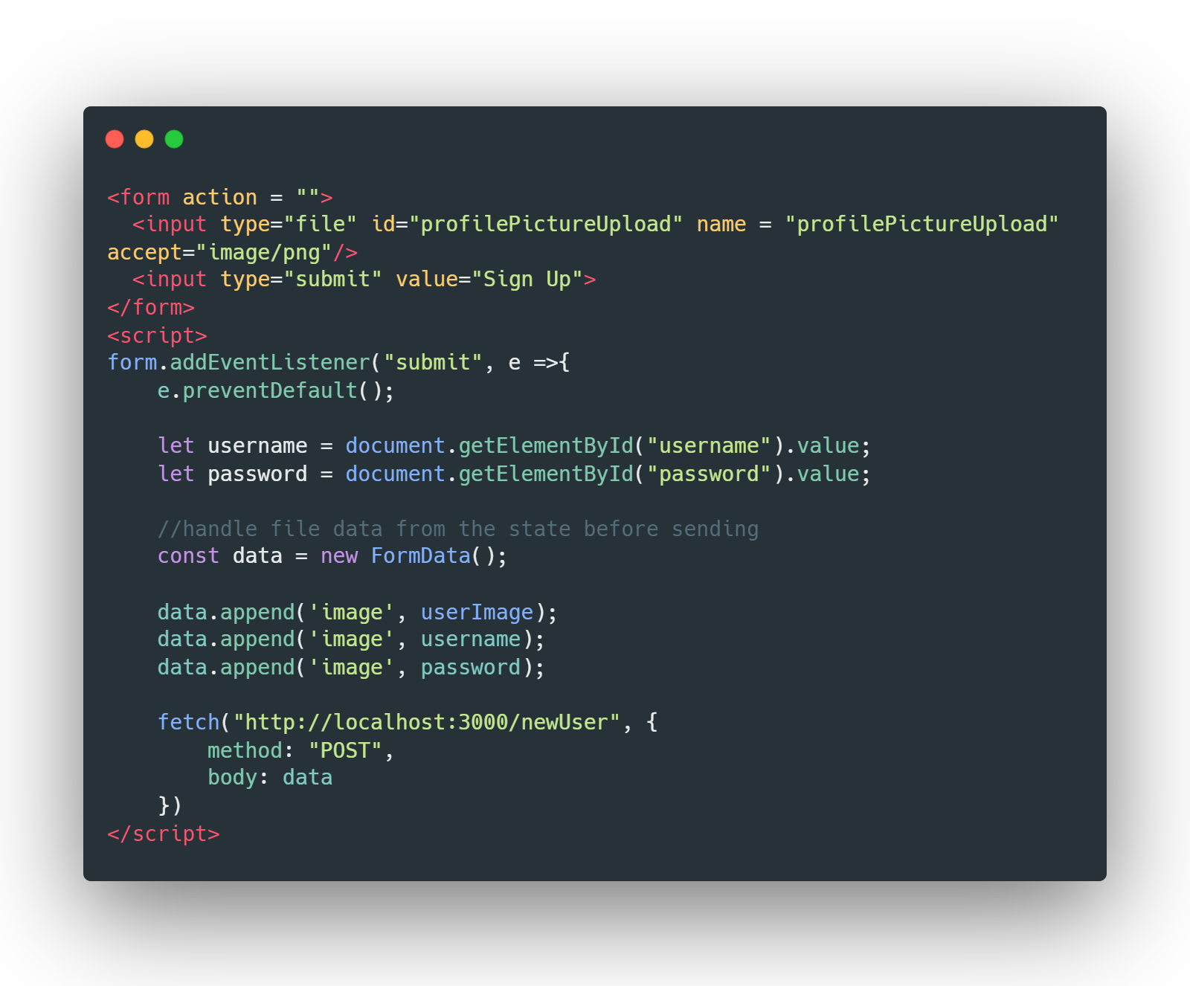
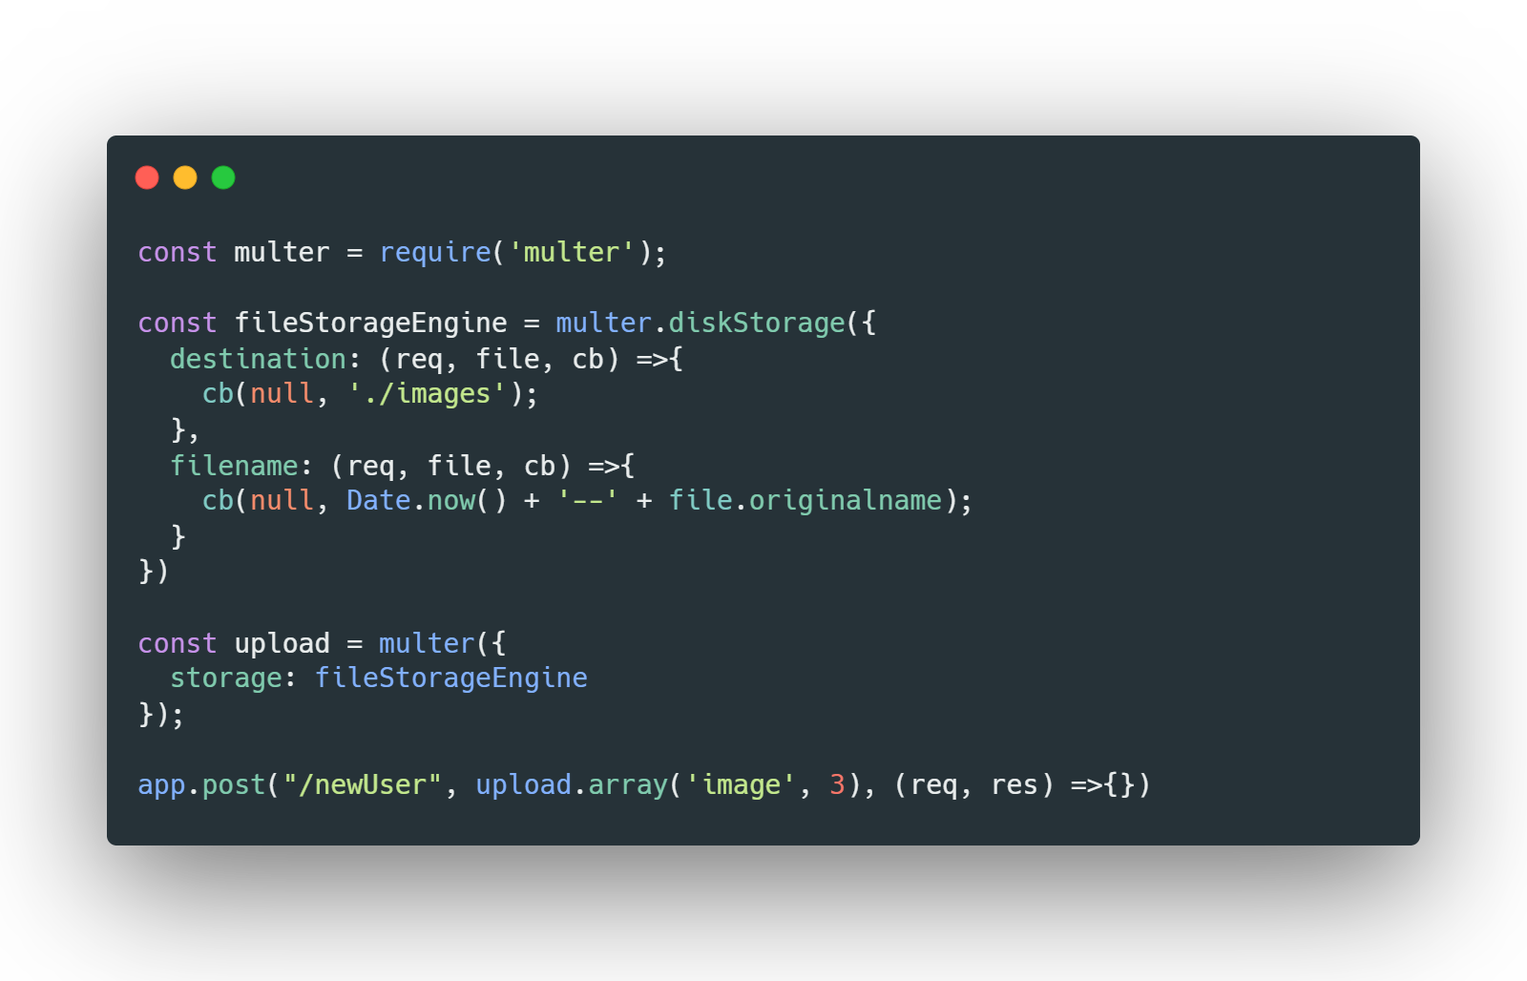
Multer is used to store the profile picture sent from the user login form

Slide 11
Profile pic upload demo

Slide 12
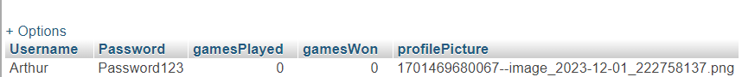
Storing user details
A database is setup using my free sql and holds all the user data

Slide 13
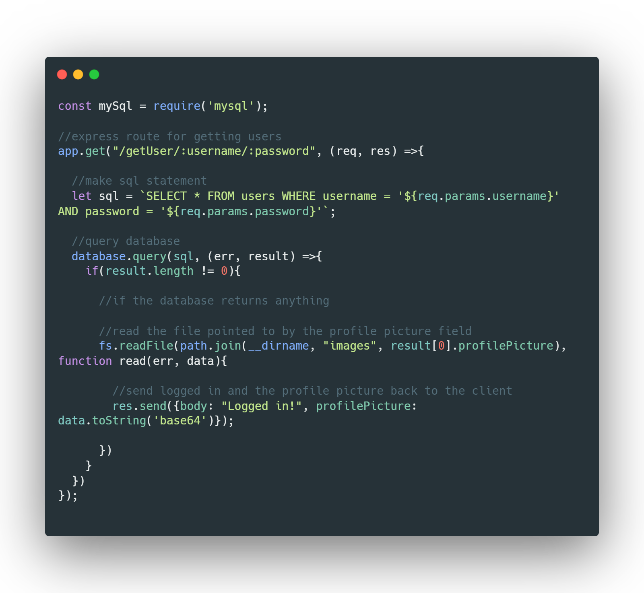
How to access Database

Slide 14
03
Login and Register
Able to register accounts and log in

Slide 15
Login and Register
Uses Html form with inputs, user enters inputs and the javascript sends a post request to the server. To log in its similar.

Slide 16
04
Optimisation
How the game has been further optimised

Slide 17
In order to make the game load faster I reduced the size of the texture files used in the environment glb model from 4k textures to 512px textures, this greatly increases the loading time, to about 3 seconds on a computer for the first time of loading into the game but after this when the model is stashed it takes 1 second to load.

Slide 18
05
Game Audio

Slide 19
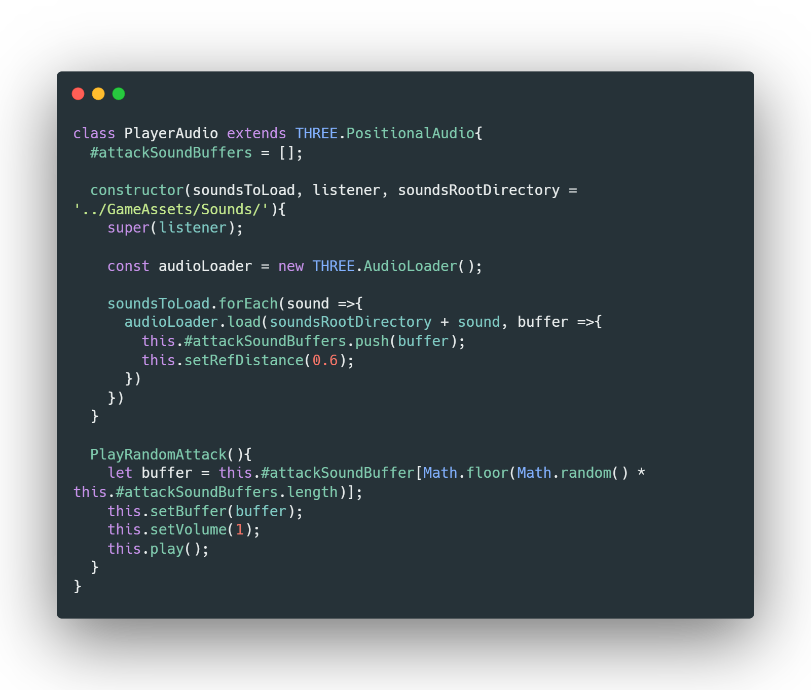
The slide title goes here!
To do player audio I created a player audio class which can be added to the player class to make it easy to play sounds on the player

Slide 20
Thanks!
Do you have any questions?

Slide 21


